Slide 1
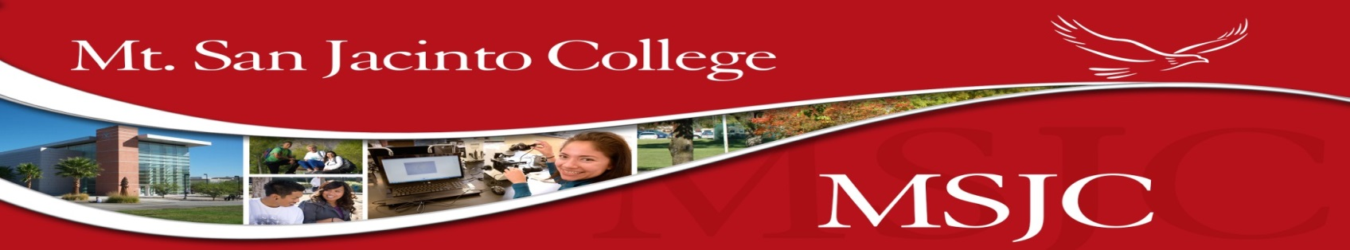

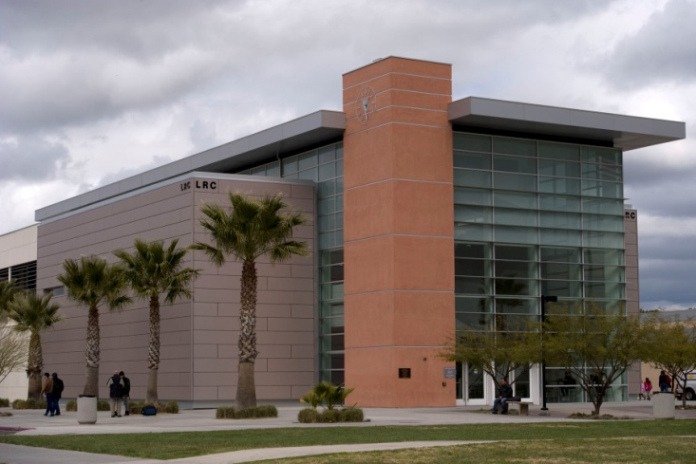
Founded: 1963
Enrollment: 18,000 +
District: 1,700 square miles
A.A. Degrees: 24
A.S. Degrees: 31
Certificates: 35
Employment Concentration Certificates: 97
President
Dr. Roger Schultz
Board of Trustees
Dorothy McGargill
Sherrie Guerrero
Ann Motte
Bill Zimmerman
Tom Ashley
Your gateway to the future,
where many opportunities await!
Welcome!

Slide 2

What we are going to talk about…
Different college systems in California
Understanding college readiness, transfer opportunities, EAP, student success and academic support
Introduce the types of courses, degrees and certificates
Becoming a student at MSJC

Slide 3
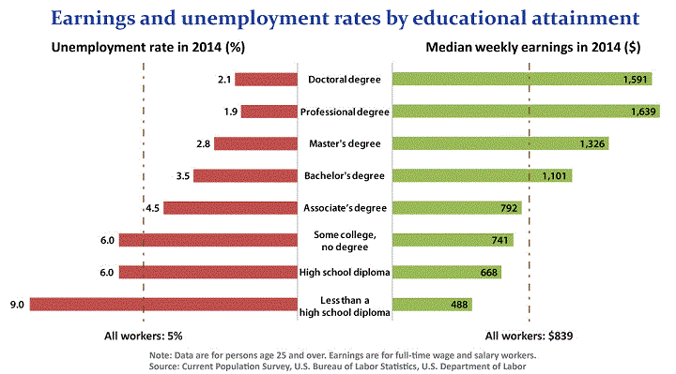
Why college?

Slide 4
Community College, Cal State University, University of California and Private Institutions
The system of higher education in California is comprised of three levels.
Community Colleges - 113
Community colleges are two-year public institutions. Their main mission is to provide transfer opportunities towards 4 year degrees by allowing students to take their general education requirements, to provide students with the opportunity to gain a 2 year associates degree, and to provide career education, training and/or certificate.
California State University (CSU) - 23
Cal States are four-year institutions and bridge the missions of the community colleges and of the universities. Cal states offer majors and courses that are applied (for example business management or graphic design) as well as academic (for example history, physics, English, or psychology).
University of California (UC) - 10
The UC's are the research wing of the California educational system. Their mission is to provide state-of-the-art discipline research in their fields, with teaching as a concurrent goal. All the majors at the UC’s are academic and research based.
Private/Independent Colleges and Universities - 76

Slide 5
The Best Way to Save $$$$!!!
2014-2015 | Community Colleges | CSU | UC | Private / Independent
Tuition and Fees | $802 - $1,104 | $5,472 - $6,920 | $13,400 | $10,515 - $56,691
Books and Supplies | $812 - $1,756 | $1,719 | $1,500 | $1,746
Living on campus | N/A | $9,200 - $14,745 | $14,200 | $8,568 - $15,800
Living off campus | $3,550 - $11,556 | $10,702 - $13,052 | $9,400 | $7,568 - $14,745
Personal Expenses | $1,226 - $3,288 | $1,226 - $1,364 | $1,226 - $1,606 | $1,226 - $1,606
Health Insurance | Included w/Tuition (Varies) | Included w/Tuition | $2,100 | Included w/Tuition (Varies)
Transportation | $800 - $1,494 | $800 - $1,494 | $800 - $1,494 | $800 - $4,652
Total Expenses | $10,750-$19,038 | $19,971-$26,242 | $31,087-$36,220 | $42,197-$78.889

Slide 6
Are You College Ready?
What does college ready mean?
  English & Math readiness
8 out of 9 Seniors are not ready to transfer to a university
Although a student may be A-G compliant, there is limited access to the universities

Slide 7
College Readiness Registration Priority
College Proficient
Completed English 101 or 103 and/or Math 105 or higher
College Ready
Ready to take English 101 and/or Math 105 or higher
Developmental
Ready to take English 92 or 98 and/or Math 90, 94, or 96
Basic Skills
Ready to take English 61 or 62 and/or Math 55 or lower

Slide 8
College Readiness
If your EAP score determines you’re “not college ready” MSJC can help!
College Ready Options:
  College Prep English 4
  ERWC
  Math Curriculum Alignment (Pilot)
  Summer Remediation

Slide 9
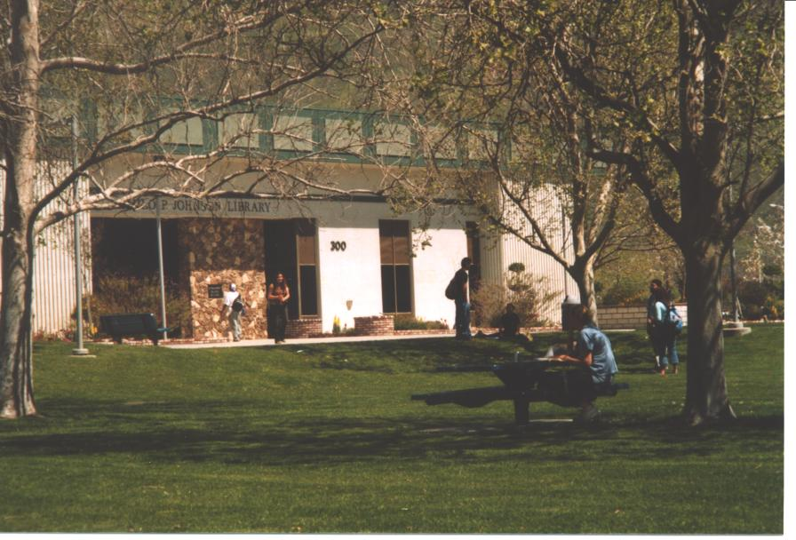
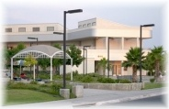
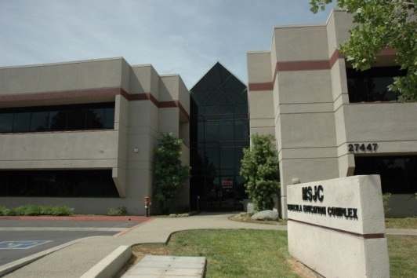
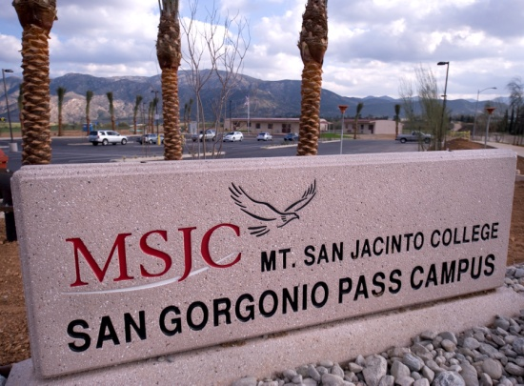
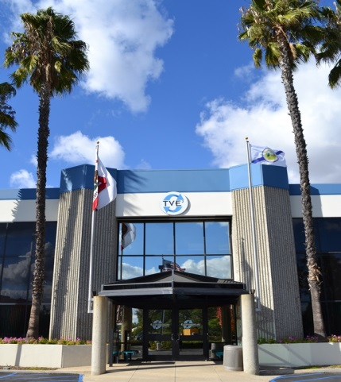
Mt. San Jacinto College
A California Community College
Five Campuses
San Jacinto Campus
Menifee Valley Campus
Temecula Education Complex
San Gorgonio Pass Campus
Temecula Higher Education Center
Plus Online Classes

Slide 10
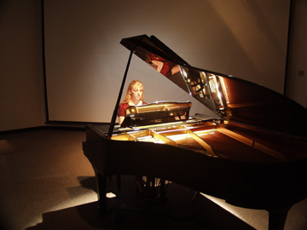
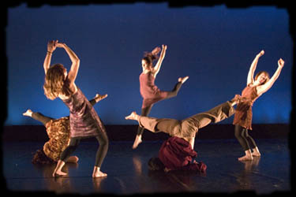
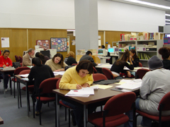
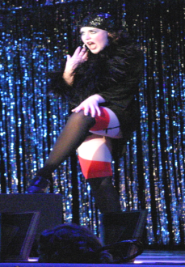
Mt. San Jacinto College
A California Community College
Set up your own schedule!
Attend full or part-time
  Daytime, Evening, and Weekend Classes
  Multiple types of courses available including Online, Short-term, Classes that start later in the term, Classes taken with your peers who are in the same major.
  Over 20,000 Students Attend MSJC!

Slide 11
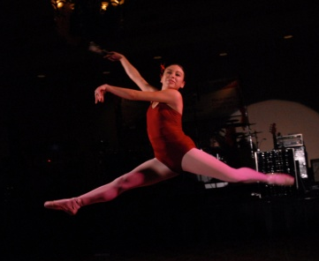



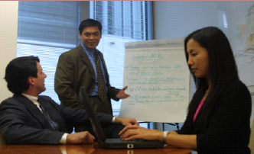
Degrees and Programs Offered at Mt. San Jacinto College
Associate of Arts Degrees (24)
Associate of Science Degrees (31)
*Transfer Opportunities*
Certificate Programs (28)
Employment Concentration Certificates (34)
Meet with a counselor to develop an Education Plan
Performing Arts
Computers
Medical
Business

Slide 12
Mt. San Jacinto College
Transfer and Articulation
Community College students have a higher application priority than those students from the K-12 system.
Community Colleges are feeder schools to highly competitive public & private universities.
You can get your AA degree and transfer with a Guarantee with your
AA-T or AS-T!

Slide 13
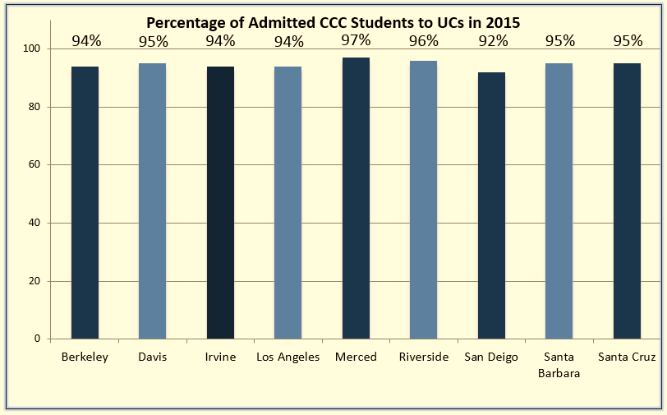
Who is Transferring!!!
Strong priority is given to transfers from California Community Colleges

Slide 14
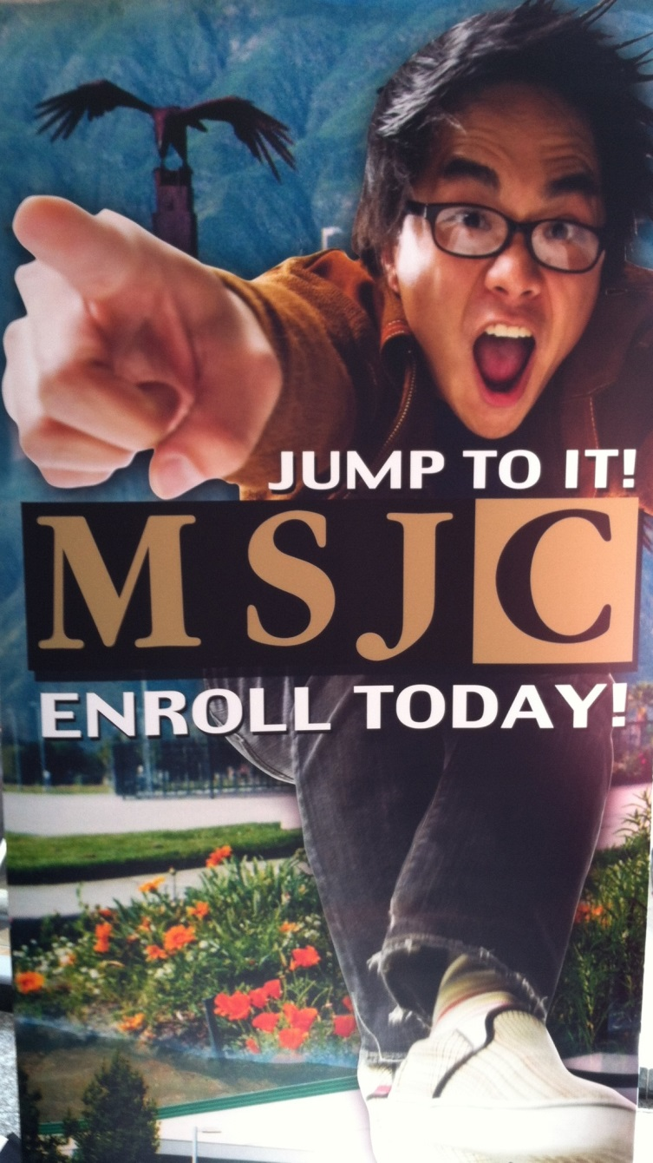
Mt. San Jacinto College
Your First Step to Success!
Online Application for Admission at; www.msjc.edu (SIDN within minutes)
Course Placement/Assessment/EAP
Online Orientation at, my.msjc.edu
Meet with a Counselor to set up your personalized education plan
If you do not have an education plan, you will not receive a registration date
Register Online -*Priority to those who are, College Ready!
Free Application for Federal Student Aid (FAFSA) and the Board of Governors Fee Waiver (optional)
All new students MUST participate in and
complete this
Matriculation Process
SENIORS!

Slide 15
Early Assessment Program (EAP)
What is EAP?:
  Provides “College Ready” feedback to High School juniors (in English and Algebra II or above) through their spring CST exam.
What YOU should do:
  Prepare – study for best possible scores
  “Bubble”-that scores be sent to BOTH the CSU and the CCC System – http://www.csusuccess.org/juniors
  If “College Ready”= exempt from assessment exams @ the Cal States and at MSJC and participating CA Community Colleges (bring scores to MSJC by June 1 senior year)
  If “Conditionally Ready English” = exempt from EPT at the Cal State IF >>> “C” or better in ERWC class taken in Senior year
  Preparation is key and it’s easy to participate in the program!
  Get College and Career Ready!

Slide 16
You are working on your Bachelor’s Degree at MSJC!!!
All 100 level and above courses that you take at MSJC are transferable to 4-Year Universities!!!
Example:
  MSJC’s English 101 Freshman Composition and Math 105 College Algebra is the exact same course that would be taken at UCs, CSUs and independent private universities!

Slide 17
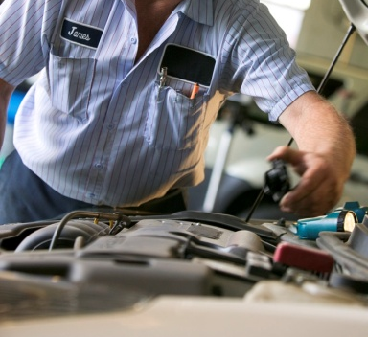
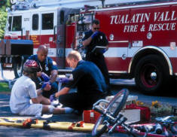



Certificates Offered
Responding to student and employer demands, MSJC offers:
Emergency Medical Technician (EMT)
Business Administration
Automotive Technology
Medical Assistant
Early Childhood Studies

Slide 18
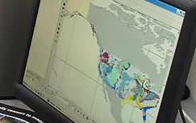
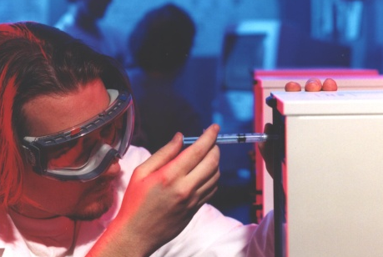
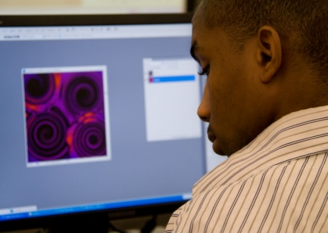

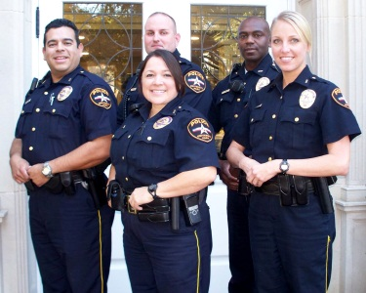
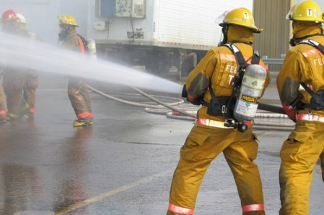

Associate of Science Degrees Offered
Geographic Information Systems
Registered Nursing
Computer Information Systems
Multimedia
Administration of Justice
Fire Technology
Water Technology

Slide 19
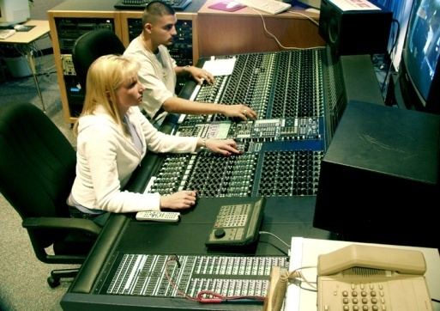

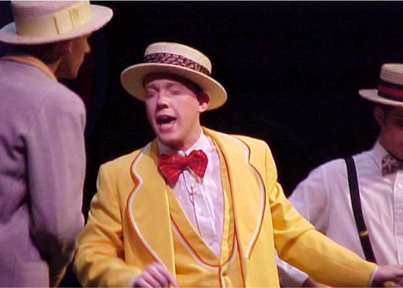
Associate of Art Degrees Offered
Audio Technology
Photography
Musical Theater
Dance

Slide 20

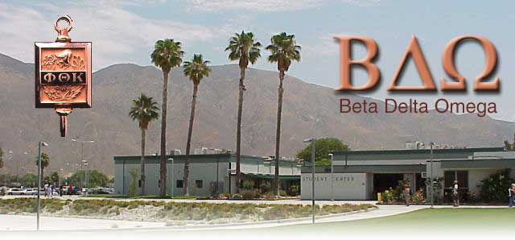
Enhance Transfer Opportunities
Honors Enrichment Program
Many public and private universities actively recruit Honors Students.
Phi Theta Kappa
International Honor Society of the
Two Year College
Transfer Admissions Guarantee Programs
TAG Agreements guarantee admission to a university upon completion of a contract developed between the student and a four-year representative from one of the universities

Slide 21
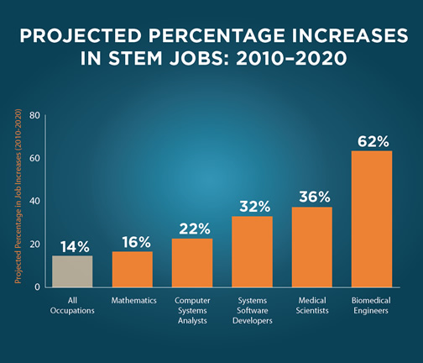
S.T.E.M.
Science
Technology
Engineering
Math
Objective:
  A program dedicated to increasing the transfer rate of STEM majors, attainment of STEM degrees, and increasing the number of students with a Student Education Plan (SEP)
Being a STEM major = rigorous coursework
  Takes support, time and dedication
MAJOR PREP-get started ASAP (Long Sequences)
Visit http://www.msjc.edu.STEM to find out more information about projects, events and the STEM Club
One-on-One Career/Educational Counseling Internship & Scholarship Opportunities Career Workshops 4-year Campus Visits | STEM Related Field Trips Summer Institute Networking Opportunities End of Year Celebration STEM Club

Slide 22









Campus Clubs &
Student Government Association
Delta Epsilon Chi
Mt. San Jacinto College
Student Services & Activities - Campus Clubs - Associated Student Body
Upward Bound
Child Development
& Education Club
Science
and
Allied Health Club
Transfer
Club
Amnesty
International
Phi Theta Kappa
Eco
Club
AAUW
Ceramics Club
SWANS
Student Nurses
Culture Club

Slide 23
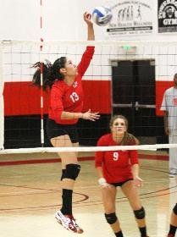
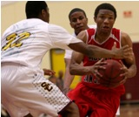

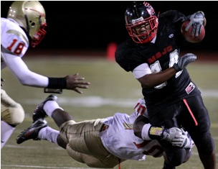
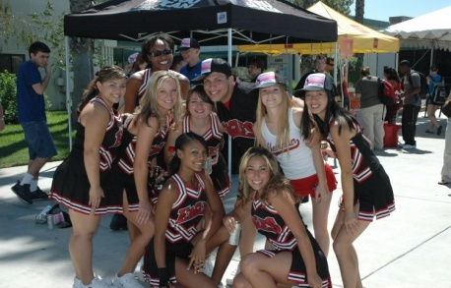
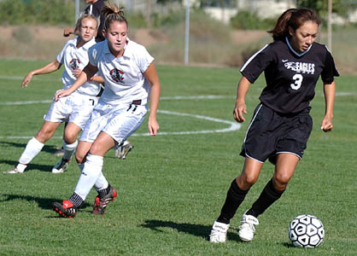
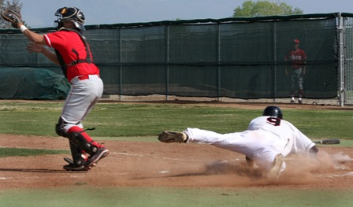
Athletics
Men
Football
Basketball
Baseball
Tennis
Golf
Women
Soccer
Volleyball
Basketball
Tennis
Softball
Golf

Slide 24
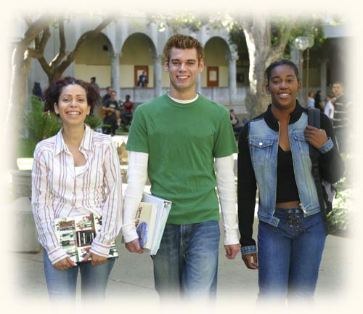

Student Services & Academic Support Services
Counseling Services with Immediate Support
Career/Transfer Center
Disabled Student Programs & Services (DSPS)
Extended Opportunity Programs & Services (EOP&S)
Cooperative Agencies Resources for Education (CARE)
College Mentors
Foster Youth
Puente Program
Academic and Personal Counseling, Establishing Educational Goals and planning, Transfer and Career Guidance
Explore career opportunities and transfer requirements
Students with IEPs from school are encouraged to contact DSPS
Income eligible, first generation college students
Part of EOP&S; Single parents on AFDC
Get Connected, Get Help
Student Support and Counseling Guidance
Transfer Program that explores the Latino/a experience through literature.

Slide 25
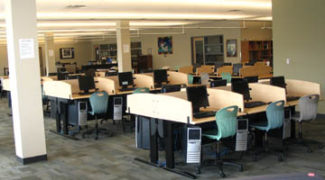
Learning Resource Center & Library
The Learning Resource Center provides a variety of services to promote the enhancement of the student’s academic goals.
Tutoring
in most subjects! Walk-in, no appointments
highly qualified student peer tutors
faculty tutors available
Computer Access
A variety of programs are available!
The LRC provides resource handouts to assist students with study skills, term papers, and a selection of other academic tasks.
All services are free for MSJC students.

Slide 26
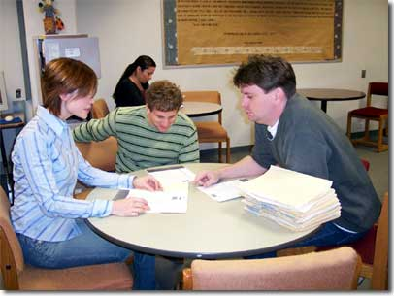
The Math and Writing Centers
MSJC students receive guidance and assistance towards completion of writing assignments in various courses.
Student Resources Include:
Study alone or in groups with peer tutors or instructors on a walk-in basis.
Writing Center Handouts
Evaluating Web Sources
MLA/APA Documentation
MSJC Library
On-line Math & Writing Centers/Labs
All services are free for MSJC students.

Slide 27
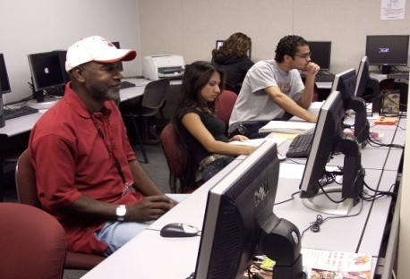
MSJC Transitional Counselors
Friendly Counselor-to-Student Assistance
Complete Enrollment and Matriculation on the web!
Complete your FAFSA Online and search for Scholarship Information!
Learn how to login and utilize my.msjc.edu for Enrollment!

Slide 28
MSJC Received a 295 Million Bond
MSJC receive a $295 Million Bond
All Locations Districtwide
Improve disabled access
Expand educational services for military veterans
Expand services for students
Upgrade technology
Install money-saving energy conservation equipment
Expand job training programs
Expand 4-year transfer pathways
A local bond will make MSJC eligible for matching funds when available from the state
Modernization of the nearly 50-year-old San Jacinto Campus
New Math/Science Building
New Cultural & Performing Arts Center with multi-use Classrooms
Completion of Menifee Valley Campus (now about 60 percent complete)
Math/Science building
Athletics facilities - Physical Education - Kinesiology
San Gorgonio Pass
Construct & Equip Permanent Facility

Slide 29
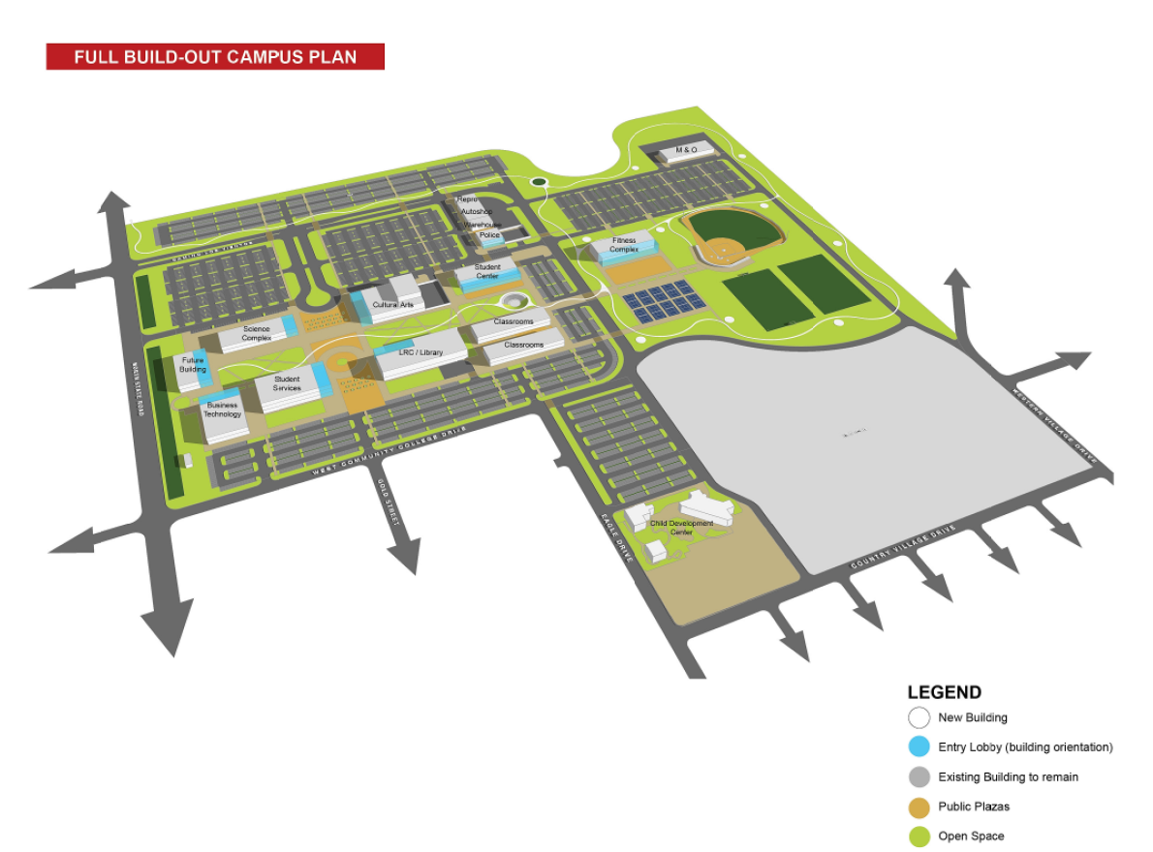
San Jacinto Campus
San Jacinto Campus
By 2020 to serve: 10,600

Slide 30
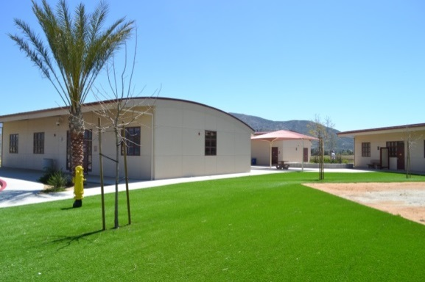
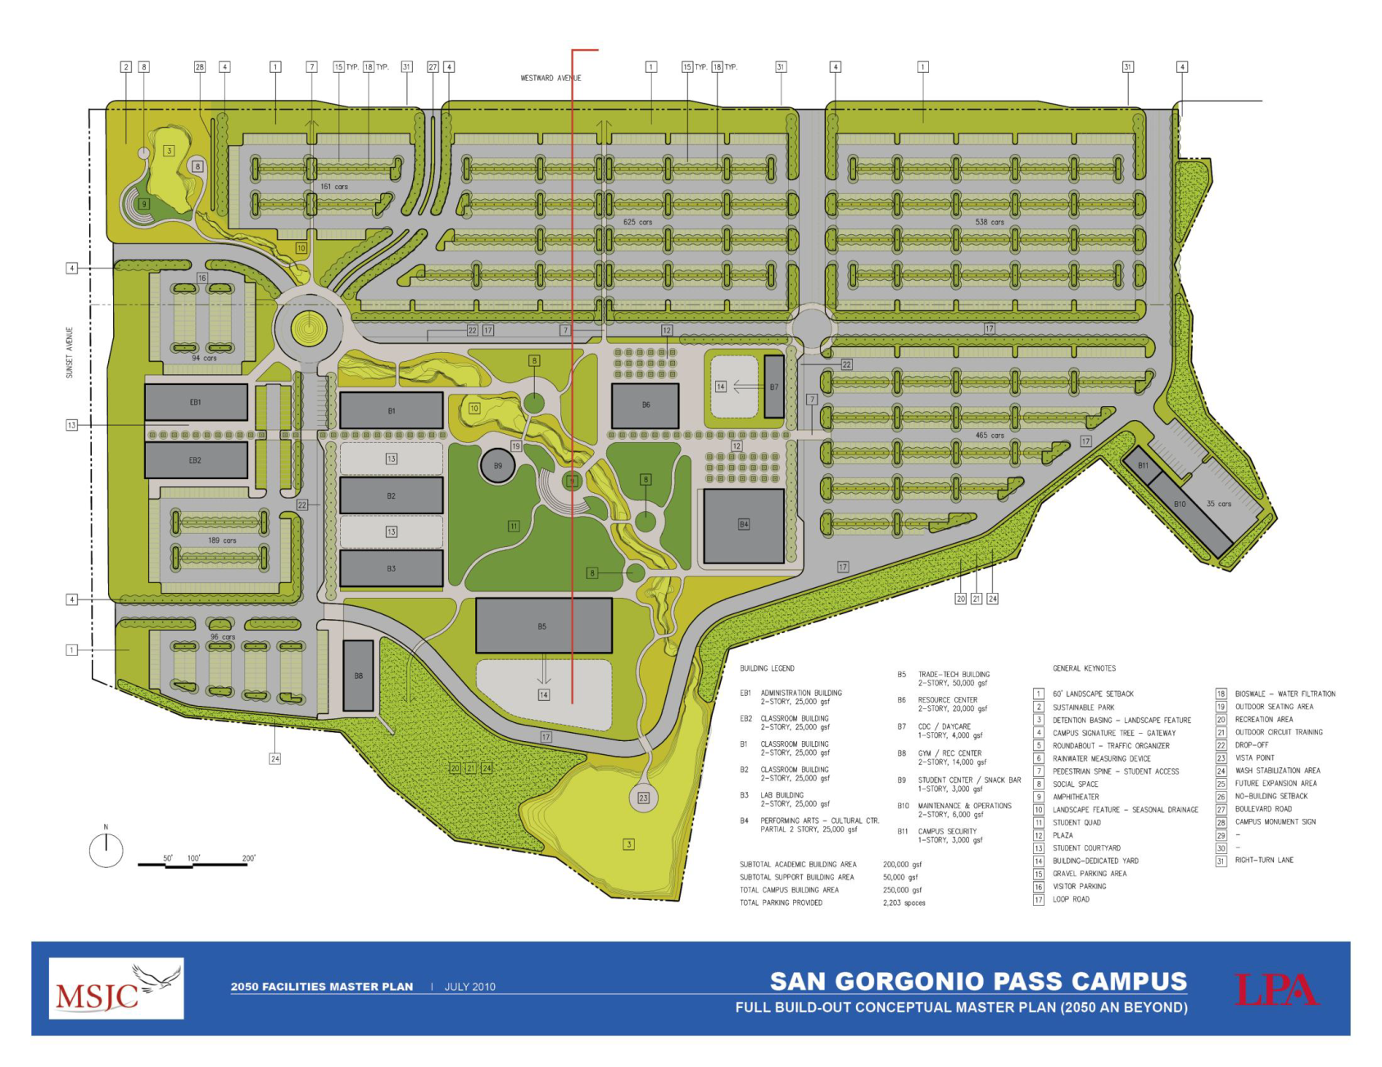
San Gorgonio Pass Campus
Currently serves: 500
By 2020 to serve: 5,000

Slide 31
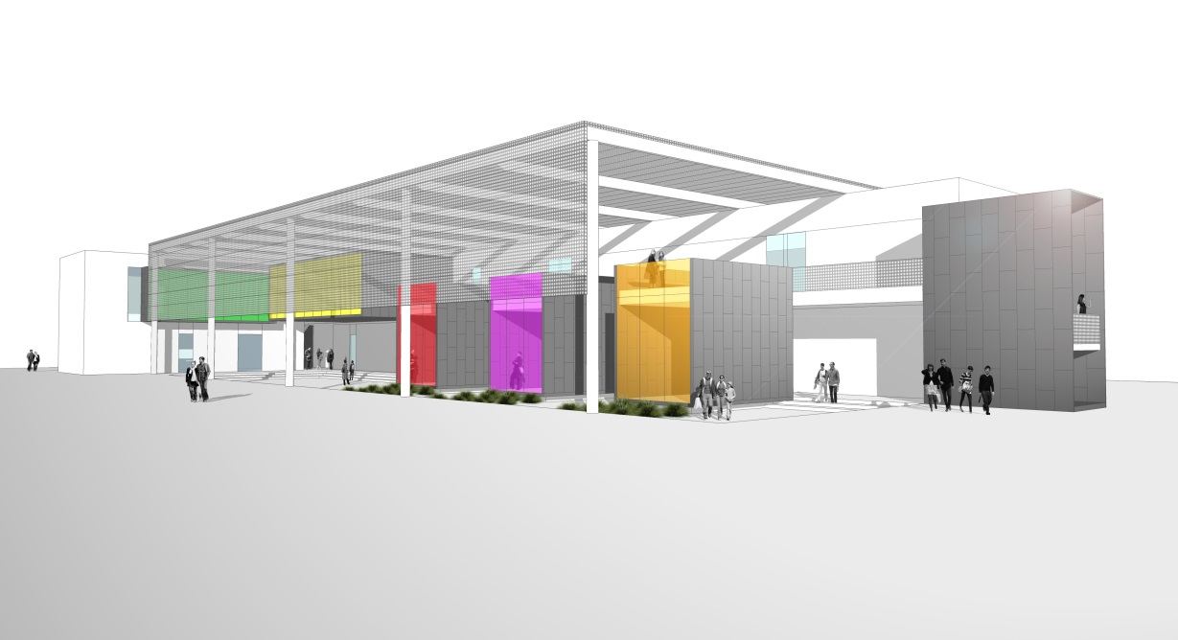
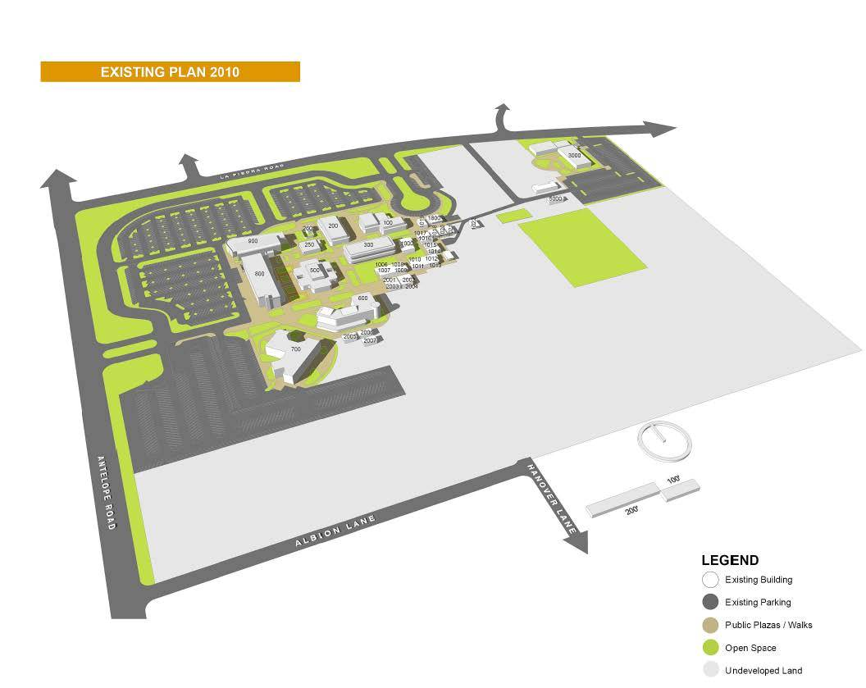
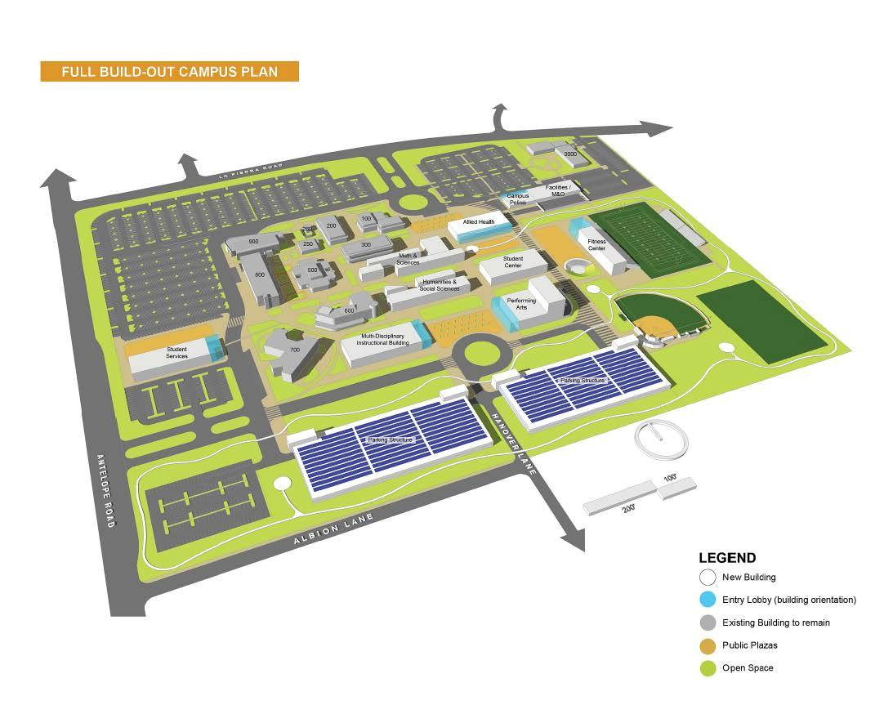
Menifee Valley Campus
Today
Future Allied Health Building
2050
Currently serves about: 8,000
By 2020 to serve: 13,000

Slide 32
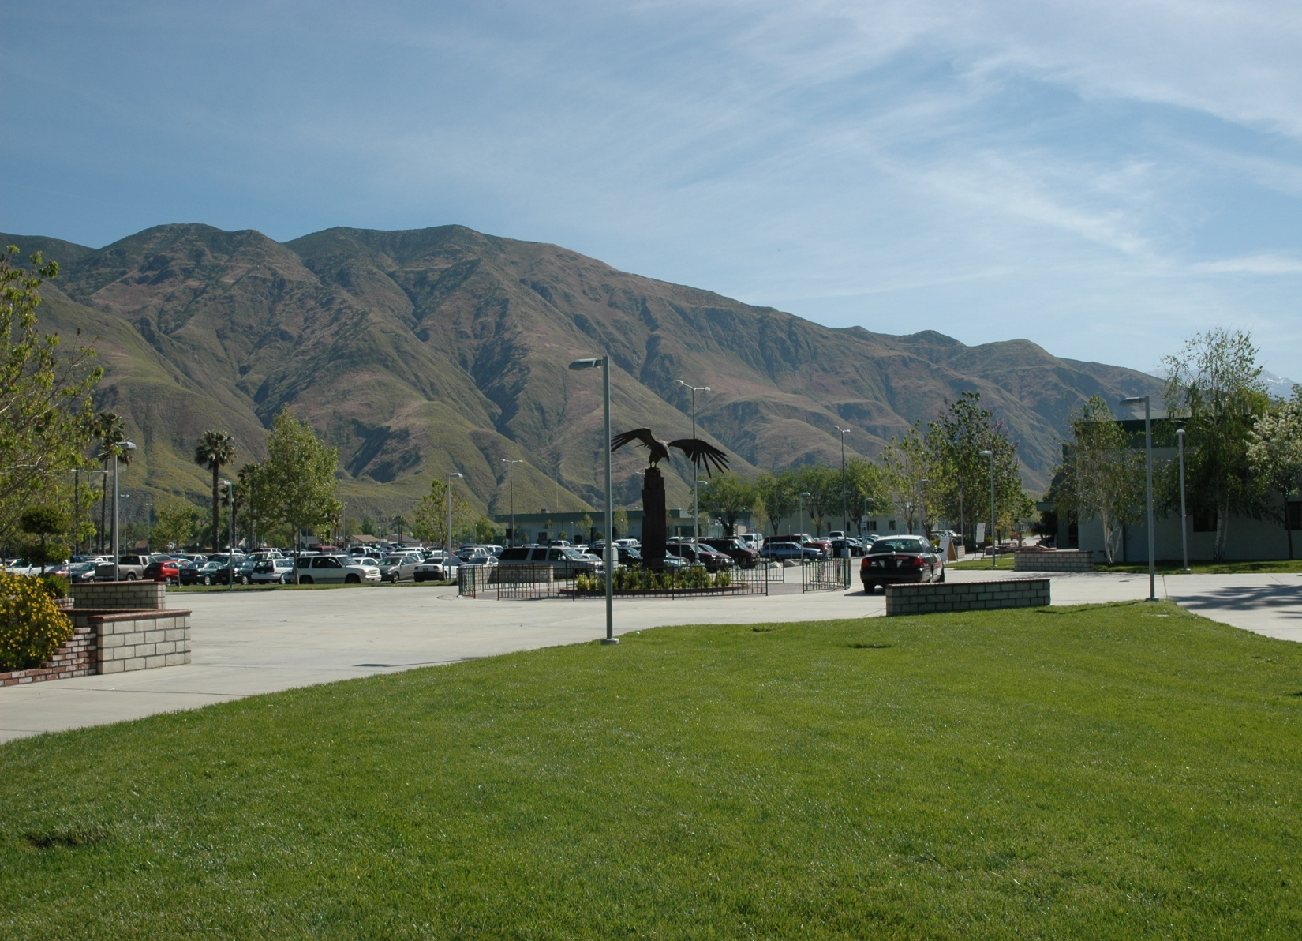

Any Questions?
Thank You!
Outreach MSJC

